Slide 1
SCC211 Operation System
(Pitfall)
Zhang Jinyu – zjy@bjtu.edu.cn
School of Computer and Information Technology
SD408

Slide 2

Objectives
Common pitfalls in concurrent programming
̶ Non-correctness
̶ Deadlock
̶ Livelock
̶ Flawed mutual exclusion
有疵瑕的互斥

Slide 3
Non-correctness
It’s very easy to introduce subtle programing errors into concurrent programs
Unidentified or incorrectly-protected critical sections leading to race conditions.
不能控制别人
在并发程序中引入微妙的编程错误是非常容易的
未识别或保护不正确的临界段导致竞争状态。

Slide 4
Why subtle?
In a sequential program, given identical input, things happen deterministically (i.e. in the same order)
This is not the case in a concurrent program (sometimes work)
This has led to the design of special concurrent programming languages that try to aid correctness (Eiffel, CSP, SR)
在一个顺序程序中，给定相同的输入，事情是确定性地发生的，。但在并发程序中却不是这样

Slide 5

Deadlock Scenario
Wants the other train to retreat so can pass

Slide 6
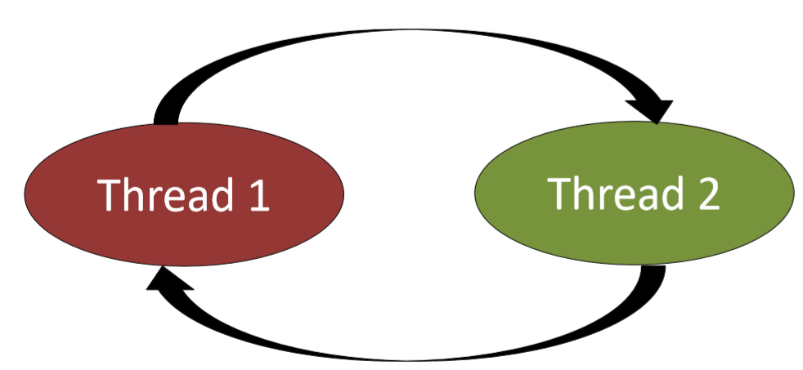
Deadlock
两个或多个线程永远阻塞，等待彼此放弃资源。
Two or more threads are blocked forever waiting for each other give up the resources.

Slide 7
Deadlock
4个必要条件
资源互斥
进程需要独占访问他们正试图获得资源
Mutual exclusion of resources
Processes need exclusive access to the resources they are attempting to obtain
1
持有和等待
在等待另一个资源时，允许进程持有资源。
Hold and wait
Processes are allowed to hold a resource while waiting for another resource
2
Non-preemption of resources
Resources may not be forcibly taken away from a process
不可剥夺资源
资源不能从进程中强制拿走
3
循环等待
进入一个进程循环的可能性，每个进程等待“下一个”进程持有的资源
4
Circular wait
Possibility of getting into a cycle of processes where each process waits for a resource held by the ‘next’ process

Slide 8
Deadlock in Threads
Very typical with incorrect lock ordering
public void run() {
synchronized (lockA)
{ System.out.println(“Thread 1 acquires lockA”);
try {
Thread.sleep(100);}
catch (Exception e) {…}
synchronized (lockB) { System.out.println(“Thread 1 acquires lockB”);}
Thread 1
得到A，得不到B
Thread1.start();
Thread2.start();
Main()
public void run() {
synchronized (lockB)
{ System.out.println(“Thread 2 acquires lockB”);
try {
Thread.sleep(100);}
catch (Exception e) {…}
synchronized (lockA) { System.out.println(“Thread 2 acquires lockA”);}
得到B，得不到A
Thread 2

Slide 9
Dealing with Deadlock
考试题
如何解决死锁：
1.设置优先级
2. 回滚
1
Program design so circular wait never occurs
– Impose total ordering on resources and requiring all processes request resources in that same order
对资源进行完全排序，并要求所有流程以相同的顺序请求资源
Prove formally a program is deadlock free before running
– Very difficult, except for small and simple programs
– Think back to the pop quiz question 1 in Worksheet 1…
2
在运行之前正式地证明一个程序没有死锁
Detect deadlock at runtime, and try recover automatically – Selectively abort processes
– Roll back to an earlier state
3
在运行时检测死锁，并尝试自动恢复有选择地中止进程
回滚到较早的状态
Manual corrective action
– Ctrl + C
– Reboot!
– Kick the machine?
4
手动纠正措施

Slide 10
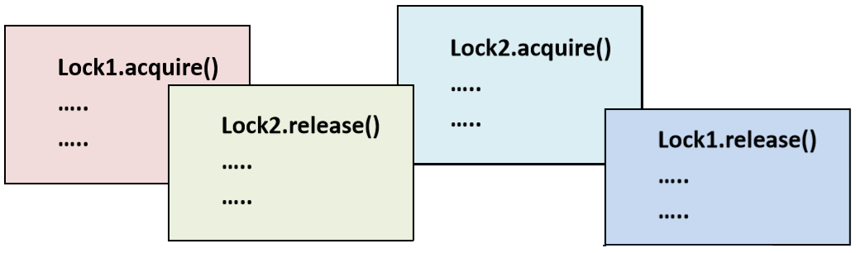
Deadlock
考试题
Lock1.acquire()
Lock2.acquire()
Lock1.release()
Lock2.release()
Lock1.acquire()
Lock2.acquire()
Lock2.release()
Lock1.release()
Deadlock
Safe
同一个锁acquire和release必须相连
Harder across multiple methods or functions…

Slide 11

Livelock scenario
After you
No, after you
No, I insist…

Slide 12
Livelock
Process can’t make progress for a reason other than deadlock (typically the process is still actively changing)
Can occur if deadlock detection repeatedly triggered
In priority-based scheduler a process will ‘starve’ in situations where there is always a runnable process with higher priority
Unlike deadlock, livelock may in principle be eventually resolved spontaneously
与死锁不同，活锁在原则上可能最终会自动解决
然而，它经常会陷入一个不确定的livelock“槽”，因此，livelock通常和死锁一样不受欢迎
However, often drops into an indefinite livelock ‘groove’, hence livelock is often as undesirable as deadlock

Slide 13
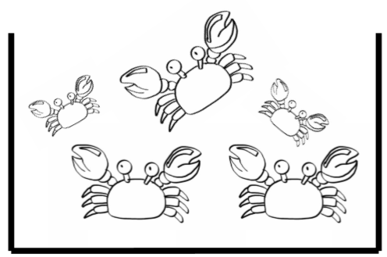
Starvation
Process is unable to obtain regular access to shared resources
进程无法获得对共享资源的常规访问
Problematic for greedy threads of algorithm design
Some threads might acquire a lock for a long time…
Timing constraints for multiple phases makes this difficult…
小螃蟹饿死了
高优先级始终运行

Slide 14
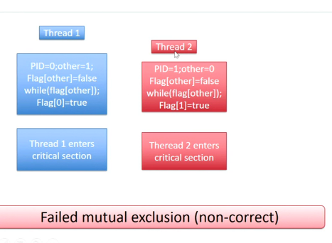
Peterson’s Algorithm
解决死锁
int[] flag = {FALSE, FALSE}; /* shared */
public void get_lock() {
int pid = Thread.currentThread();
int other = 1 - pid;
while(flag[other]); /* other’s flag is raised */
flag[pid] = TRUE; /* raise my flag */ }
public void release_lock()
{ flag[Thread.currentThread()] = FALSE; }
都进入了临界区
If both processes call get_lock() when flag[0] and flag[1] == FALSE, both may enter the critical section
Failed mutual exclusion (non-correct)

Slide 15
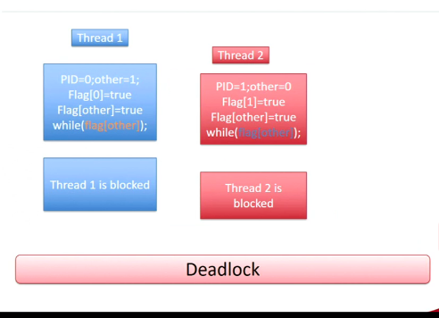
Peterson’s Algorithm
How about raise my flag before I look at the other process flag?
int[] flag = {FALSE, FALSE}; /* shared */
public void get_lock() {
int pid = Thread.currentThread();
int other = 1 - pid;
flag[pid] = TRUE; /* raise my flag */
while(flag[other]); /* other’s is set */}
public void release_lock()
{ flag[Thread.currentThread()] = FALSE; }
都卡在while
spinned
spinned
Both processes might ‘simultaneously’ set flag[pid] to TRUE
Deadlock

Slide 16
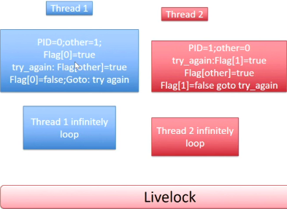
Peterson’s Algorithm
Break deadlock by ‘backing’ off if other process flag is raised after
回退
int[] flag = {FALSE, FALSE}; /* shared */
public void get_lock() {
int pid = Thread.currentThread();
int other = 1 - pid;
try_again: flag[pid] = TRUE; /* raise my flag */
if (flag[other]) { /* check other’s flag */
flag[pid] = FALSE; /* lower mine */
goto try_again:
  }
}
public void release_lock() { flag[Thread.currentThread()] = FALSE; }
无限回退
Both processes may now back off simultaneously forever
Livelock

Slide 17
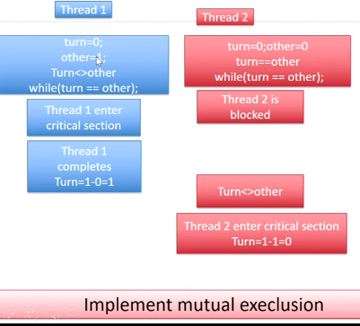
Peterson’s Algorithm
Different tactic – force two processes to obtain lock alternatively
int turn = 0; /* shared */
public void get_lock() {
int other = 1 - Thread.currentThread();
while(turn == other); /* if other’s turn, spin */ }
public void release_lock() { /* now give the other process his turn... */
turn = 1 - Thread.currentThread(); }
Provides mutual exclusion – doesn’t work unless application ensures two processes always call get_lock() alternately (0,1,0,1)
必须轮流执行，
单方不能连续执行
Very restricted solution

Slide 18
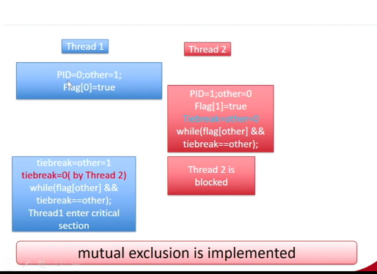
Peterson’s Algorithm
Good solution
private int tiebreak = 0; /* shared */
private bool[] flag = {FALSE, FALSE}; /* shared */
public void get_lock() {
int pid = Thread.currentThread();
int other = 1 - pid;
flag[pid] = TRUE;
tiebreak = other;
while(flag[other] && tiebreak==other); }
public void release_lock()
{ flag[Thread.currentThread()] = FALSE; }

Slide 19

Paranoid Programming
peterson 仅处理两个进程
If you are dealing with concurrent design patterns, Approach the problem methodically
如果您正在处理并行设计模式，请系统地处理该问题
Its very unlikely you can ‘code your way’ out of the problem
(Especially with 500,000 lines of code..)
Checks before, during, and after concurrency ‘hotspots’
Thread is fire, use it wisely and for a purpose!
  Does each thread complete its exact function?
  Does each thread gracefully complete?
Pen and paper does wonders
双刃剑
Remember – these issues occur at macro and micro scale

Slide 20
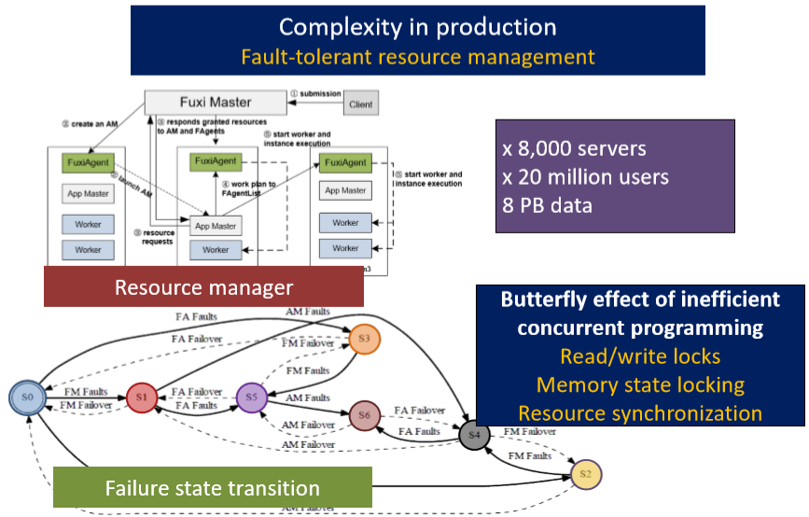
Performance
低效并发编程的蝴蝶效应
一个错误引发另一个错误

Slide 21
Summary
Some common pitfalls in concurrent programming are:
Non-correctness (subtlety wrong), deadlock, livelock, starvation
Pitfalls are nicely exemplified in ‘not quite right’ versions of Peterson’s algorithm
Trying to provide mutual exclusion without any special hardware or OS support
Pitfalls occur at macro and micro scale within systems.
  Fine-grained concurrency is usually more complex
彼得森算法的“不太正确”版本很好地说明了陷阱

Slide 22
Question？

